Slide 2

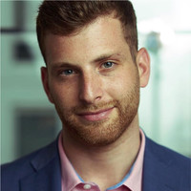

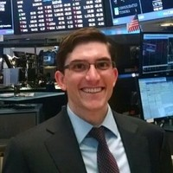
Slide 10
THE TEAM
Group Member
Group Member
Group Member
Team Lead
Charles Biggar
Don Leshem
Drew Seelig
Omar Eltorai

Slide 3

Omar: Come up with a few questions and send to Drew to add to PPT
Mission
Giter Dun analyzed a dataset of investor funding of companies in order to identify shared traits and characteristics across the companies.
At the start of the project, some of our initial questions included:
Which markets are investors focusing on?
Which companies are able to raise the most money?
Which cities have the most companies?
Describe the core message or hypothesis for your project.
Describe the questions you and your group found interesting, and what motivated you to answer them

Slide 4
TOC
Methodology
Summary
Data Review
Plot of count of companies vs. funding amounts
Total Funding by Category by City

Slide 5
Methodology
Omar: Think about what to be said here
We identified our main data set of startup investor data on Kaggle
We then reviewed the data to ensure it was useful
After we had some observations, we cleaned this data utilizing a combination of pandas and xls
We then pulled in weather data from weather api and combined with main data set
We then started to iterate on observations of the data
We discussed patterns of the data within the group
We then decided which metrics to focus on and create meaningful visualizations of the data
* [ ] Describe the data exploration and cleanup process (accompanied by your Jupyter Notebook)
* [ ] Describe the analysis process (accompanied by your Jupyter Notebook)

Slide 6
Summary
We have observed strong representations at the coasts for funding of startups, led by San Francisco and New York City.
Initial thoughts of weather influencing funding success has not been observed.
California is the top state for start-ups which is in-line with the reputation it has.
Technology and Software lead the categories of start-ups and are widely spread throughout all states.
This should include a numerical summary
Top 10 Cities by Total Funding
City | State | Total Funding | Total Investors | Average of Max Temp(F)
San Francisco | CA | $58,849,838,747 | 12052 | 69.01
New York | NY | $33,405,582,745 | 7149 | 80.01
Palo Alto | CA | $13,587,652,470 | 1909 | 71.01
Mountain View | CA | $ 9,634,591,300 | 1692 | 71.01
Cambridge | MA | $ 9,589,144,334 | 1092 | 71.6
San Jose | CA | $ 9,110,671,511 | 906 | 87.8
San Diego | CA | $ 8,309,128,786 | 843 | 73.99
Boston | MA | $ 8,278,504,756 | 1503 | 78.01
Redwood City | CA | $ 7,970,115,831 | 945 | 71.01
Chicago | IL | $ 7,435,861,102 | 1020 | 72

Slide 7
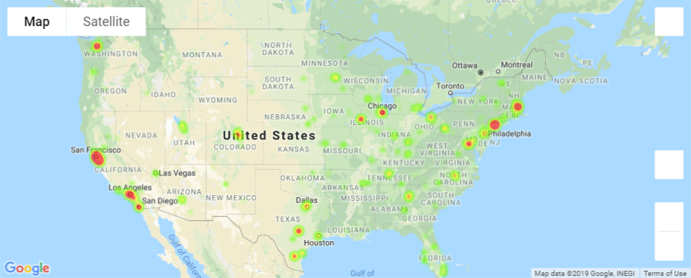
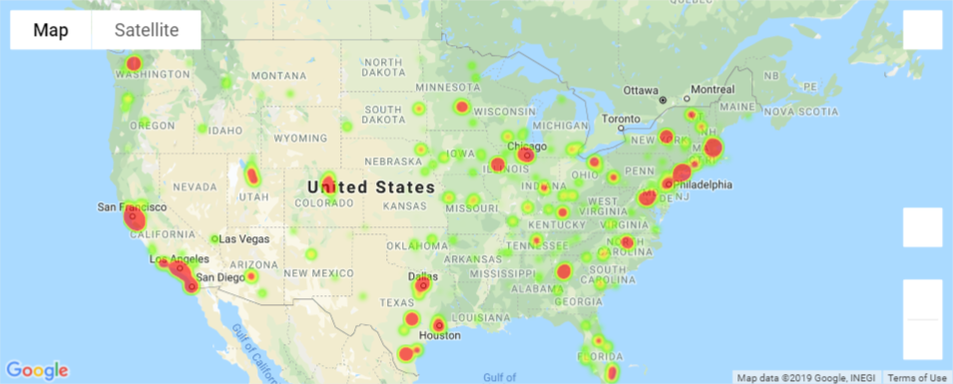
Plot of count of companies vs. funding amounts
Drew
We have observed a high number of companies in NY and CA, however total funding is more apparent in other states such as Colorado, Texas, Illinois, Washington and Florida.

Slide 8
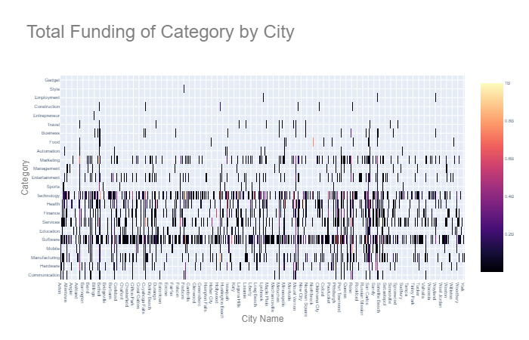
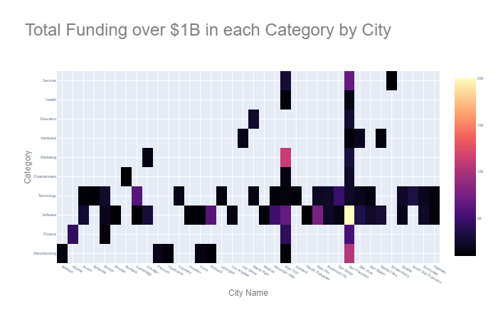

Total Funding by Category by City
Drew: To update pictures
We have observed technology and software as a popular category across all states. When we focus category funding to >$1B, we see New York and San Francisco as popular cities containing companies across most categories.

Slide 9
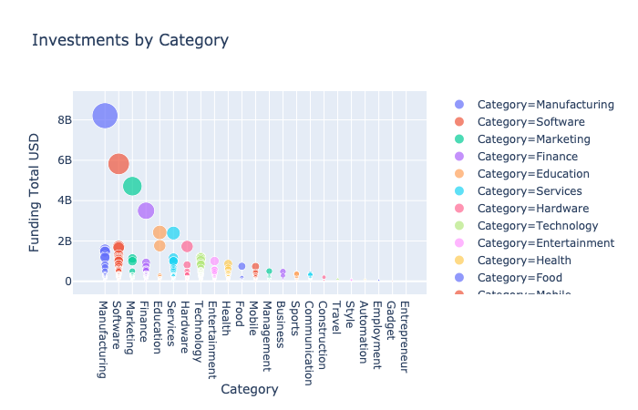
Investment by Category
Don
We have observed that manufacturing, software, and marketing are the leading categories in total investments.

Slide 10
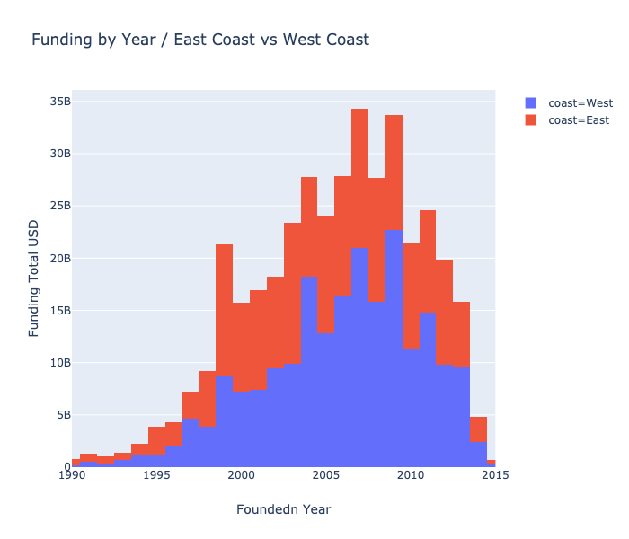
Funding by Year – East Coast vs. West Coast
Don
We have observed that the east coast dominates throughout the years, with more funding into its companies.

Slide 11
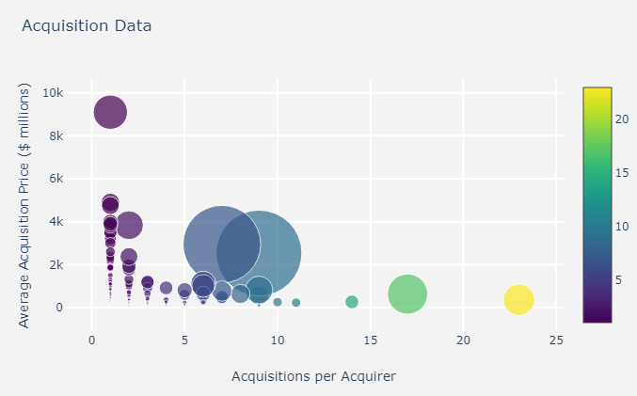
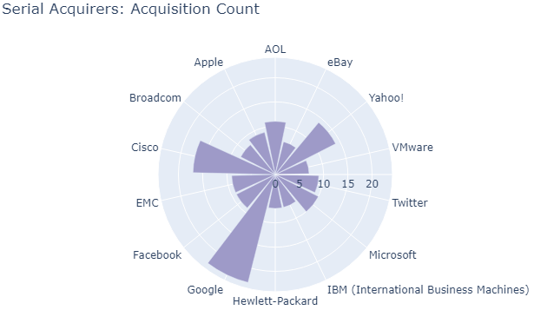
Acquisitions
OE
There were a total of 801 (5.9%) firms acquired by 494 firms (acquirers) for a total of $334 B.
The average acquisition price for the acquired firms was $339 million (skewed by larger acquisitions).
Serial acquirers, firms that acquired 7 or more companies, spent less on average than the non-serial acquirers.
Non-serial
Serial
Count
Serial
* Bubble size reflects the total spending on acquisitions by each acquirer

Slide 12
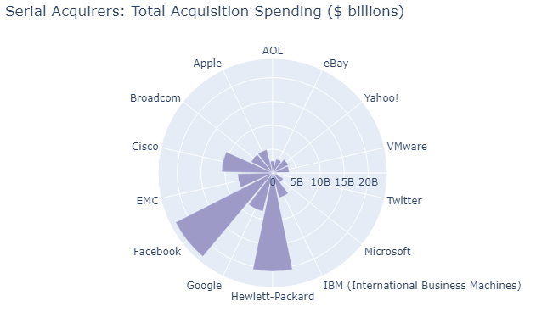
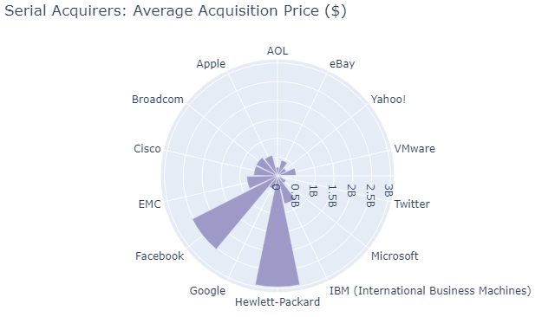
Acquisitions: Acquirers
OE
There were a total of 14 (~3% of all acquirers) serial acquirers (acquisitions >=7), which accounted for 30% ($101 B) of total acquisition spending ($334 B).
The serial acquirers are heavily in the technology industry. While Google had the most acquisitions (23 total), Facebook (9 total) and Hewlett-Packard (7 total) were standouts for most money spent and highest average acquisition price paid.

Slide 13
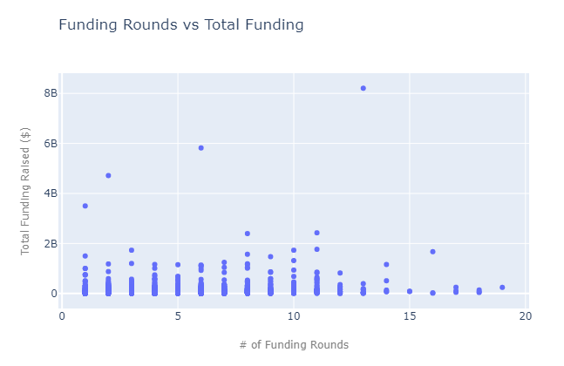
Funding Rounds
OE
Companies in the data set received $29.6 million in total funding, over an average of 2.6 funding rounds.
Limitations of the data set prevented us from drawing any supported conclusions about round-specific funding and the relationship of # of funding rounds to total funding raised – both of which would be worth further exploration and analysis.

Slide 14
* Discuss any difficulties that arose, and how you dealt with them * Discuss any additional questions that came up, but which you didn't have time to answer: What would you research next, if you had two more weeks?
Post Mortem

Slide 15
Questions?

